Slide 1
T
OTAL
H
EALTH ARE
C
A Clinic for all your needs…

Slide 2
Acknowledgement
We have taken efforts in this project. However, it would not have been possible without the kind support and help of many individuals and organizations. We would like to extend our sincere thanks to all of them.
We are highly indebted to Mr. Naveen Kalra for his guidance and constant supervision, as well as for providing necessary information regarding the project and also for his support in completing the project.

Slide 3
Why do we need a Clinic Website?
Nowadays, people are seeking a convenient way of being reserved on their appointments. So do in clinic reservation process. In this situation, therefore, Online Clinic Reservation System is a good project to ease on difficult and too time consuming manual appointment reservation processes.
An Online Clinic website offers Health Professionals a more efficient and convenient way for patients to reserve appointments in the clinic. It’s the future in appointment scheduling in clinic. Patients can book an appointment that is convenient for them, which clinic’s staff is able to control and maintain patients’ information through a computerized process.

Slide 4
How is it helpful ?
Online Clinic website is a centralized web portal for health appointments where patients find and book an appointment with their health practitioner online. The system is synchronized with reservation system and saves the front office staff countless interruptions during their already busy day and helps provide a more customer friendly experience to patients.

Slide 5
Specific Objectives
To provide a convenient way of appointment
reservation for patients.
To computerized the patients’ information review
and maintenance.
To give clinic staffs an easy way in doing
information maintenance and updates.

Slide 6
Scope
The Online Clinic Reservation System has the following scope:
The online scheduler which contains all the doctors’ available time of
appointment.
Information can be easily updated, reviewed, and maintained.
For patients, only information related to their reservation will be displayed through their account website.
For clinic staffs, the information of both doctors and patients can be reviewed on system’s main server.

Slide 7
Now let’s move to the Website itself

Slide 8
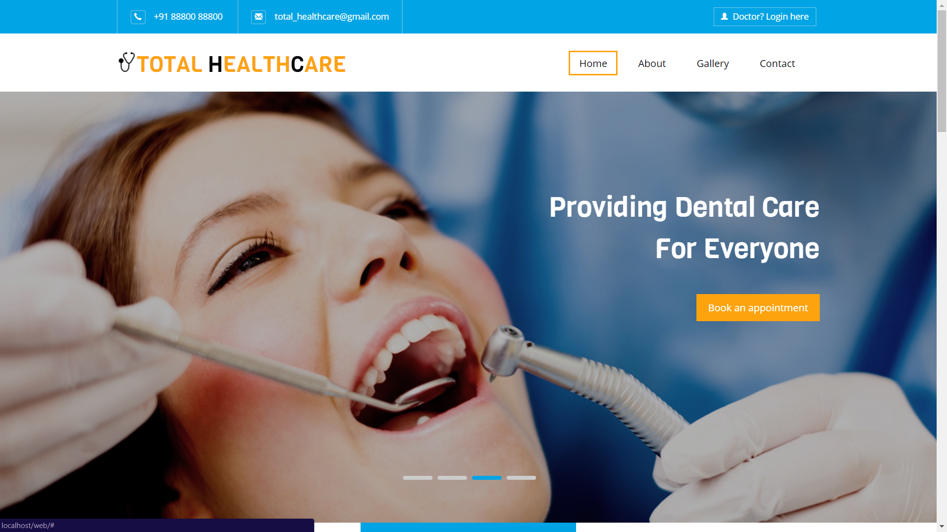
The Home Page
Doctor can login
Using this button
Navigation
Is Easy

Slide 9
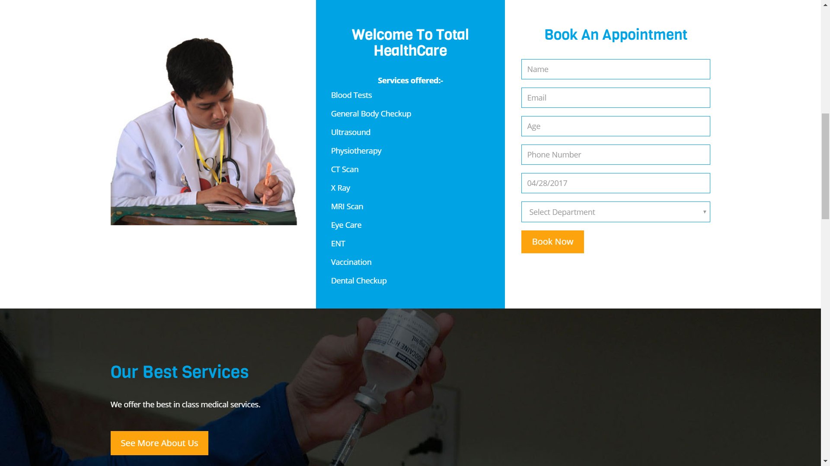
Appointment Booking Panel

Slide 10
With the correct Login details, the Doctor’s Panel can be accessed.
The following Email ID(s) and Password(s)
can be used to access the Doctor’s Admin Panel
Email ID | Password
doctor1@gmail.com | password
doctor2@gmail.com | password

Slide 11
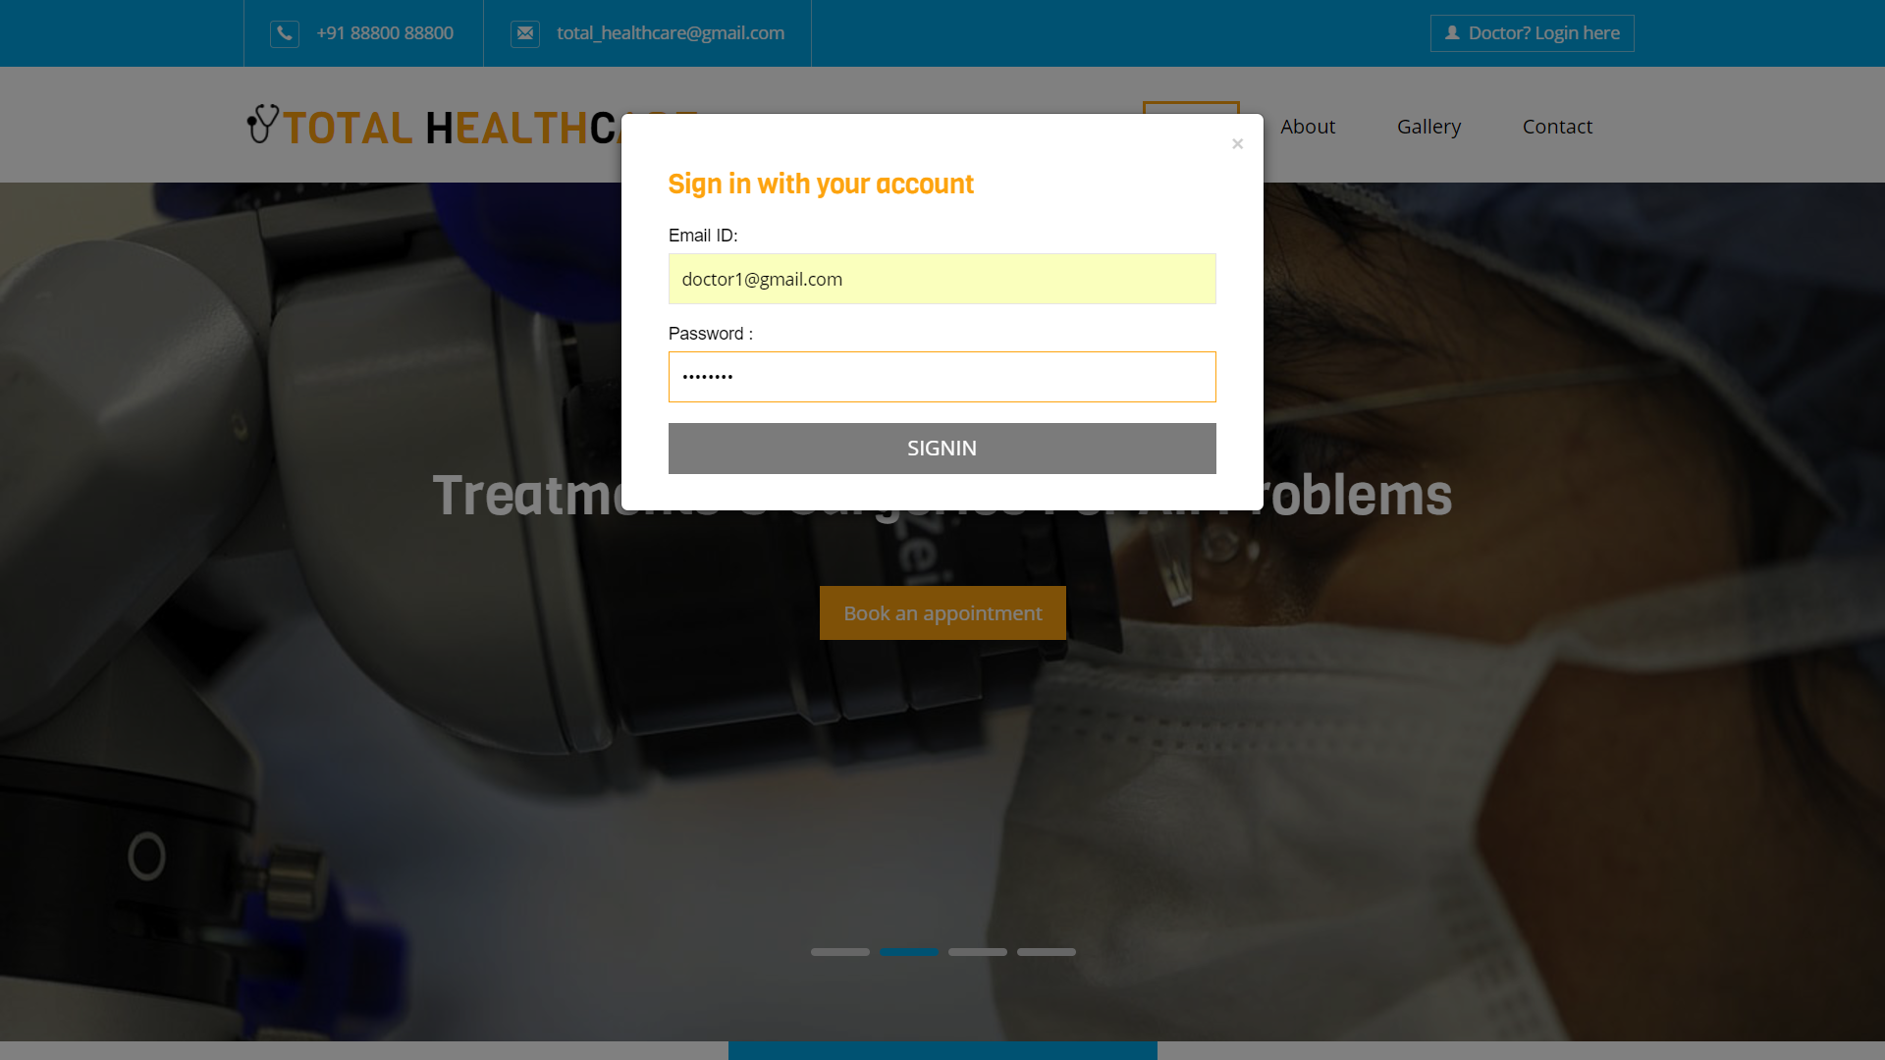
Doctor’s login

Slide 12
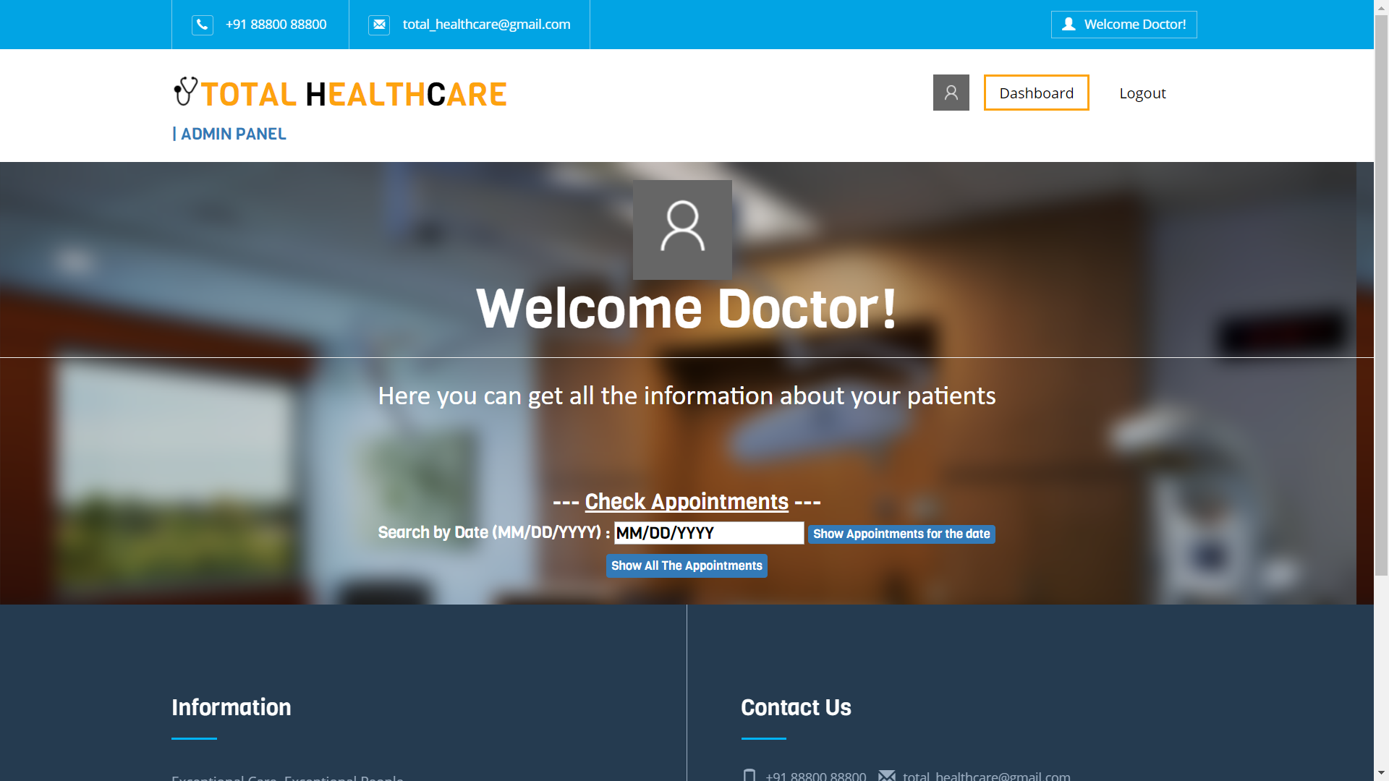
Doctor’s Panel

Slide 13
However, if you try to login with invalid details, you’ll be greeted by this message

Slide 14
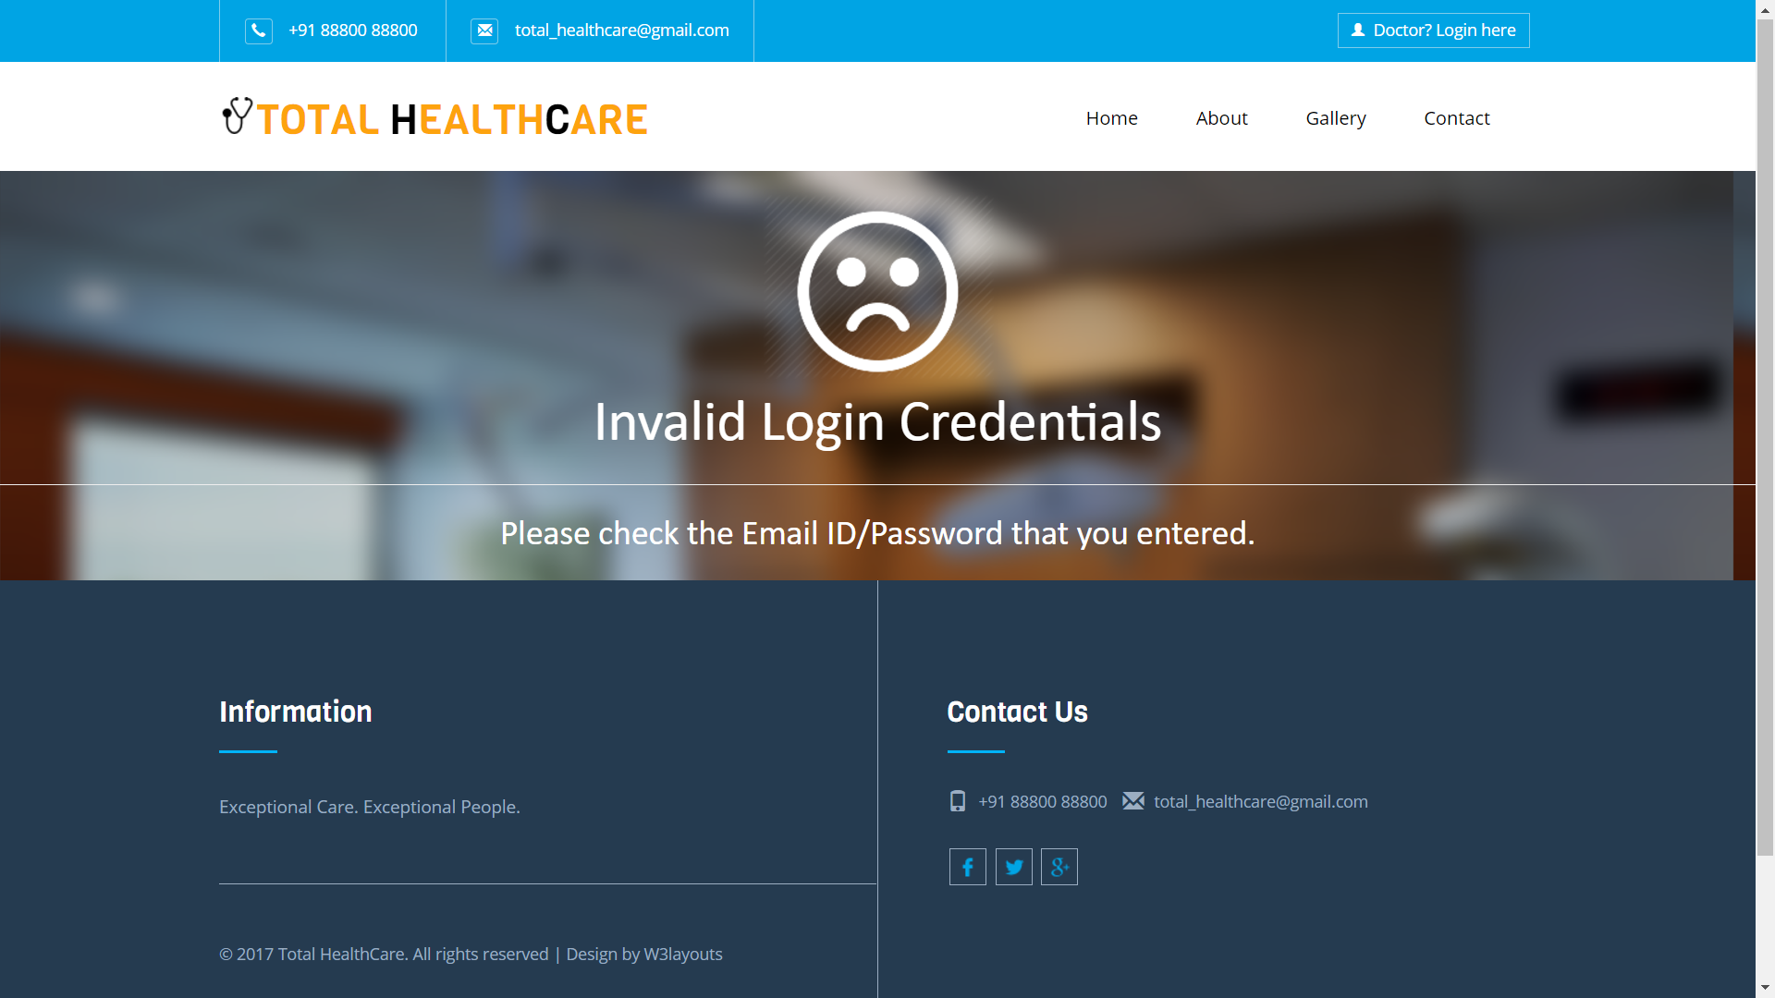

Slide 15
Now, let’s see the options available for the Doctor at his/her Admin Panel

Slide 16
Doctor’s Panel
This option acts as
a hyperlink for
Admin Panel Dashboard
Logs out from
Admin Panel
This option displays
the Appointments for the
chosen date
This option displays
all the Appointments made
till date

Slide 17
Upon choosing any of the options,
the Patient Records will be displayed
as per the option chosen.

Slide 18
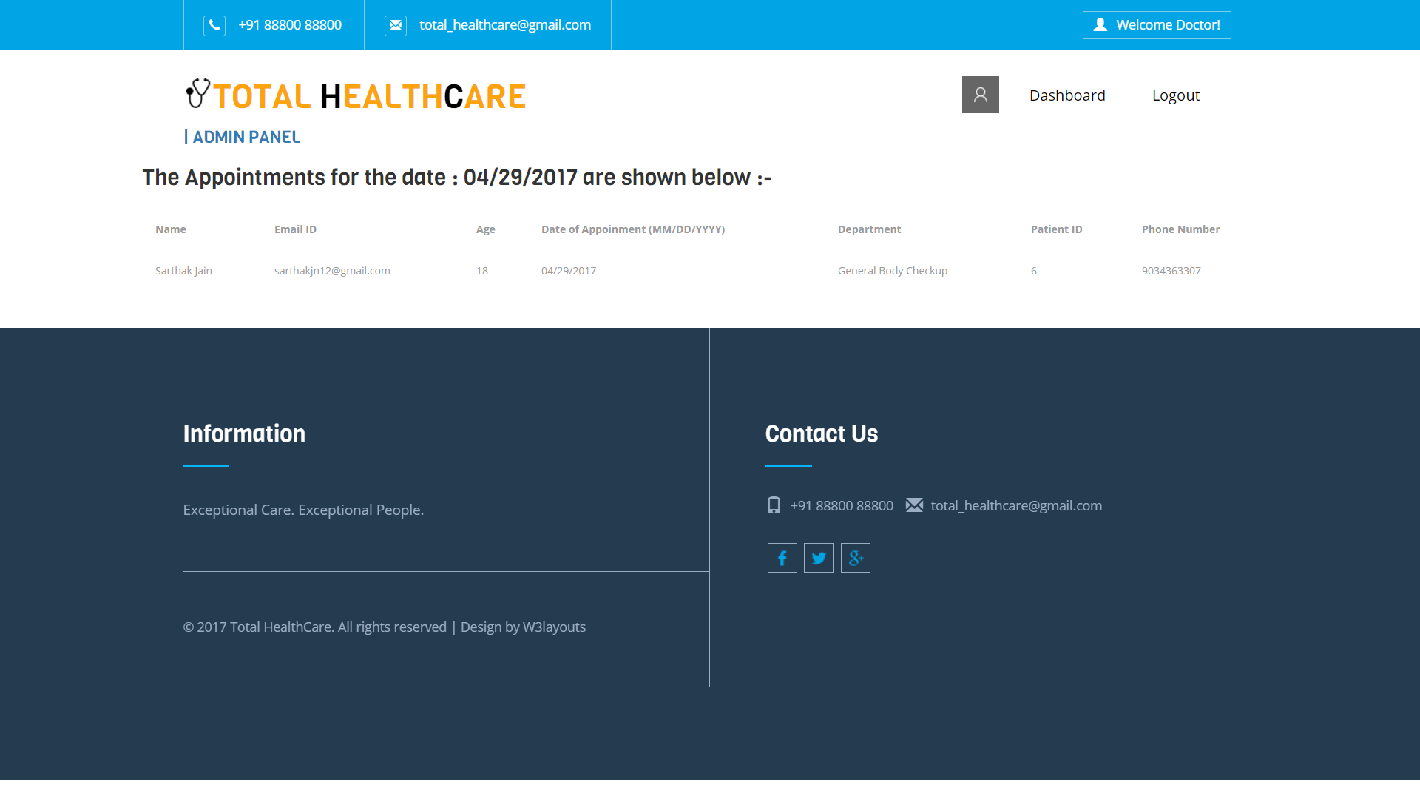
A sample of how the Patient Records will be shown to the Doctor

Slide 19
Thanks for your support! We hope that you liked it.

